Slide 1
Chapter 1 The Fundamentals: Logic and Proofs
Section 3
Propositional Equivalences

Slide 2
Propositional equivalences
Replace a statement with another statement with the same truth value
For efficiency (speed-up) or implementation purpose (e.g., circuit design)

Slide 3
Outline
Tautology（重言式）, Contradiction（矛盾 ） & Contingency
Logical Equivalence
Constructing new logical equivalences

Slide 4
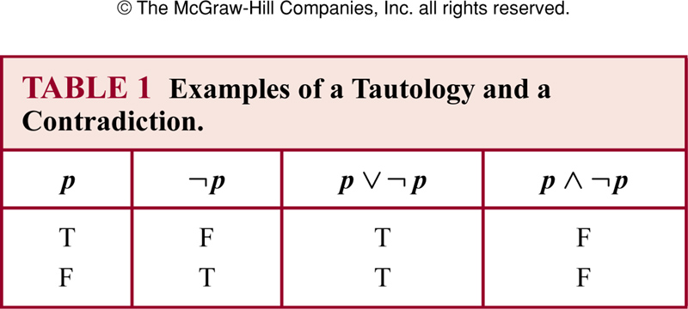
Tautology and contradiction
Tautology (重言式)
  A compound proposition that is always true
Contradiction / Absurdity (矛盾式)
  A compound proposition that is always false
Contingency (不定式)
  A compound proposition that is neither a tautology nor a contradiction

Slide 5
Logical equivalence
Logical Equivalence (逻辑等价)
  The compound propositions p and q are logically equivalent if p ↔ q is a tautology, denoted by p ≡ q ( or p ⇔ q )
  Can use truth table to determine whether two propositions are equivalent or not

Slide 6
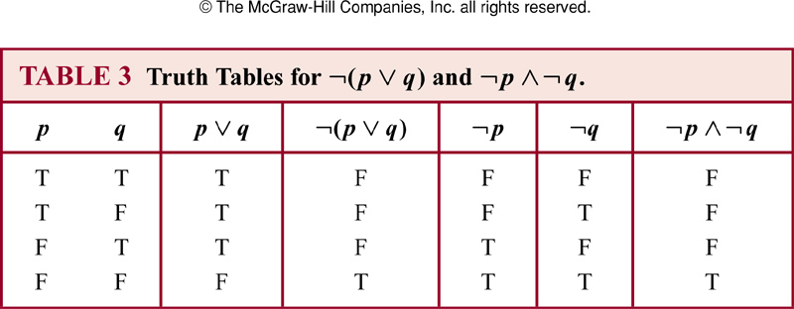
Logical equivalence
Example
  ¬(p ∨ q) ≡ ¬p ∧ ¬q

Slide 7
Logical equivalence
Example
  p → q ≡ ¬p ∨ q
Truth Tables for p → q and ¬p ∨ q
p | q | p→q | ¬p ∨ q
T | T | T | T
T | F | F | F
F | T | T | T
F | F | T | T

Slide 8
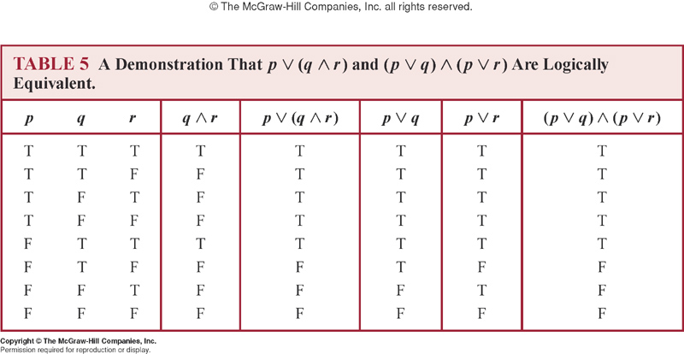
Logical equivalence
Example
  Distributive law of disjunction over conjunction

Slide 9
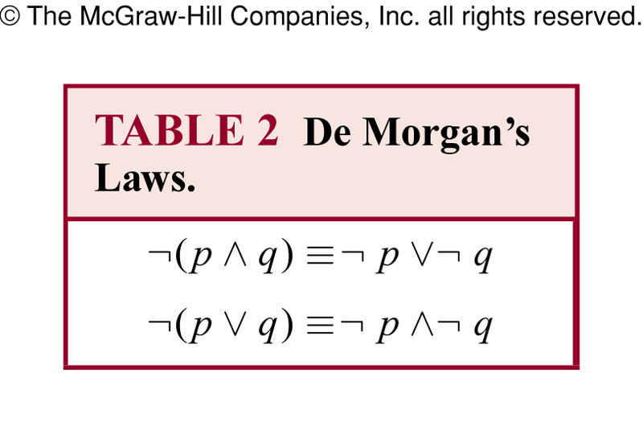
Logical equivalence
Example
  Try to prove De Morgan’s laws by making use of truth tables

Slide 10
Logical equivalence
Example
  Express the negation of “Heather will go to the concert or Steve will go to the concert” by De Morgan’s law
  Solution:
    Heather will not go to the concert AND Steve will not go to the concert.

Slide 11
Logical equivalence
Example
  De Morgan’s law: in general form
    ¬( p₁∨ p₂∨ … ∨ p_{n} ) ≡ ( ¬p₁∧ ¬p₂ ∧ … ∧ ¬p_{n} )
    ¬( p₁∧ p₂ ∧ … ∧ p_{n} ) ≡ ( ¬p₁∨ ¬p₂ ∨ … ∨ ¬p_{n} )

Slide 12
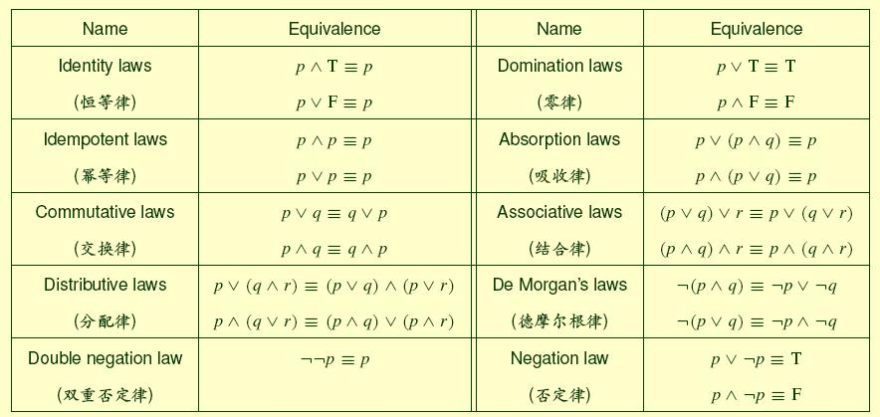
Logical equivalence
Some important equivalences

Slide 13
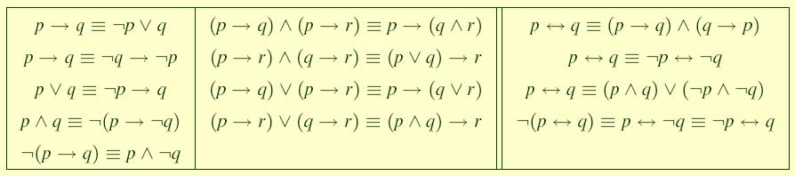
Logical equivalence
Some important equivalences involving implications and biconditionals

Slide 14
Constructing new logical equivalences
The rule of replacement (等值替换规则)
  The logical equivalences that have been established can be used to construct additional logical equivalences
  A proposition B in a compound proposition A can be replaced by a proposition B’, constructing a new compound A’. If B’ ≡ B, then A’ ≡ A
Some obvious results
  If A ≡ A’ then ¬A ≡ ¬A’
  If A ≡ A’ and B ≡ B’ then
    A ∧ B ≡ A’ ∧ B’
    A ∨ B ≡ A’ ∨ B’
    A → B ≡ A’ → B’
    A ↔ B ≡ A’ ↔ B’

Slide 15
Constructing new logical equivalences
Remark
  By the rule of replacement we can make a kind of recurrent equations.
Example
  Show that ¬(p → q) ≡ p ∧ ¬q
  Solution
    ¬(p → q) ≡ ¬(¬ p ∨ q) // p → q ≡ ¬ p ∨ q
    ≡ ¬(¬ p) ∧ ¬q // the De Morgan law
    ≡ p ∧ ¬q // the double negation law

Slide 16
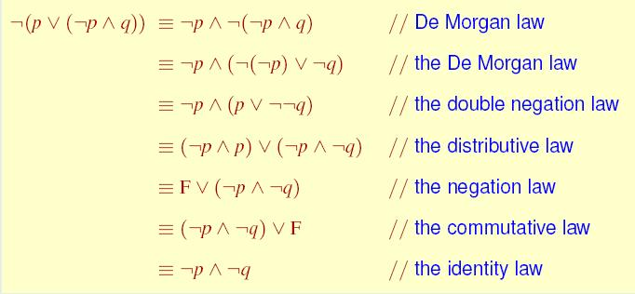
Constructing new logical equivalences
Example
  Show that ¬(p ∨ (¬p ∧ q)) ≡ ¬p ∧ ¬q
  Solution

Slide 17
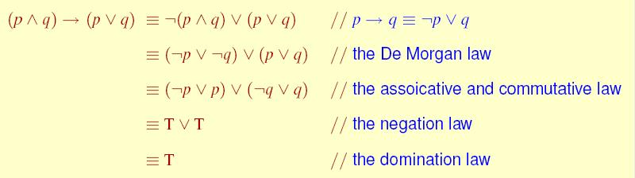
Constructing new logical equivalences
Example
  Show that (p ∧ q) → (p ∨ q) is a tautology
  Solution

Slide 18
Propositional satisfiability
Satisfiability (可满足性)
  A compound proposition is satisfiable if there is an assignment of truth values to its variables that makes it true. When no such assignments exists, that is, when the compound proposition is false for all assignments of truth values to its variables, the compound proposition is unsatisfiable (it is a contradiction now).
  Note that a compound proposition is unsatisfiable if and only if its negation is true for all assignments of truth values to the variables, that is, if and only if its negation is a tautology.

Slide 19
Propositional satisfiability
Satisfiability
  When we find a particular assignment of truth values that makes a compound proposition true, we have shown that it is satisfiable; such an assignment is called a solution of this particular satisfiability problem.
  To show that a compound proposition is unsatisfiable, we need to show that every assignment of truth values to its variables makes it false, i.e., it has no solution. Although we can always use a truth table to determine whether a compound proposition is satisfiable, it is often more efficient not to demonstrates.

Slide 20
Propositional satisfiability
Example
  Determine whether each of the compound propositions is satisfiable.
    (p ∨ ¬q) ∧ (q ∨ ¬r) ∧ (r ∨ ¬p)
    (p ∨ q ∨ r) ∧ (¬p ∨ ¬q ∨ ¬r)
    (p ∨ ¬q)∧(q ∨ ¬r)∧(r ∨ ¬p)∧(p ∨ q ∨ r)∧(¬p ∨ ¬q ∨ ¬r)
  Solution:

Slide 21
Limitations of proposition logic
Example
  Suppose we know “Every computer connected to the university network is functioning properly”
  Now no rules of propositional logic allow us to conclude “MATH3 is functioning properly” where MATH3 is one of the computers connected to the university network
  Proposition logic cannot adequately express the meaning of statements

Slide 22
Limitations of proposition logic
Example
  We cannot use the rules of propositional logic to conclude from “CS2 is under attack by an intruder”, where CS2 is a computer on the university network, to the truth “There is a computer on the university network that is under attack by an intruder”

Slide 23
Assignment
Assignment after 1.3: No. 10.d), 26

